Slide 1
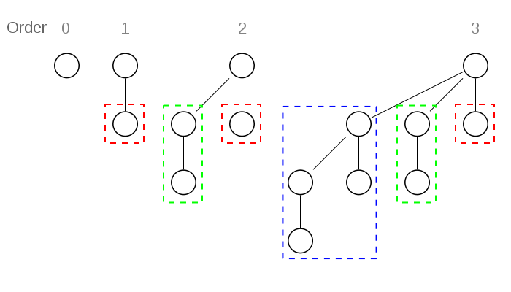
2. Binomial Heap
Binomial Heap is defined by Binomial tree.
Binomial tree is an ordered tree that can be recursively defined as:
  A binomial tree of order 0 has a single node.
  A binomial tree of order i has a root node whose children are root nodes of binomial trees of order i-1, i-2, …, 2, 1, 0.
Example
Notes:
B0=0
B1 = B0+1 B2 = B1+B0+1,
Bi = Bi-1 + … + B1 +B0 + 1
Bi-1 = Bi-2 + B1 +B0 + 1
Bi-Bi-1 = Bi-1, Bi= 2Bi-1

Slide 2
Properties of Binomial Tree
A binomial tree order i, denoted B_{i} , has 2^{i} nodes
The height of a binomial tree B_{i} is i
The root has i children
A binomial tree B_{i} consists of two binomial trees B_{i-1} linked together such that root of one is the leftmost child of the root of the other
There are C(i, h) node at level h
Notes:
B0=1
B1 = B0+1 = 2
B2 = B1+B0+1,
Bi = Bi-1 + … + B1 +B0 + 1
Bi-1 = Bi-2 + B1 +B0 + 1
Bi-Bi-1 = Bi-1, Bi= 2Bi-1
Bi = 2 * Bi-1 = 2* 2* Bi-2 = 2 * 2 *…* 2 = 2^I
there are exactly k i _x0001_ nodes at depth i for i = 0, 1, . . . , k, and 4. the root has degree k, which is greater than that of any other node; moreover if the children of the root are numbered from left to right by k − 1, k − 2, . . . , 0, child i is the root of a subtree Bi .
H(B1) = 1
h(Bi) = I
h(Bi+1) = h(Bi) + 1 = i+1, true. By mathematical induction, h(Bi) = 1.

Slide 3
Binomial Heap
A Binomial Heap is a set of Binomial Trees with two properties:
  each binomial tree follows min-heap property
  there can be at-most one binomial tree of any degree.
7
9
11
27
10
14
36
16
12
18
21
19

Slide 4
Binomial Heap
Derived properties:
root of each binomial tree contains the smallest key in the tree
a binomial heap H of N nodes contains at most log N + 1 binomial trees
Notes:
The second property implies that an n-node binomial heap H consists of at most ⌊lg n⌋ + 1 binomial trees. To see why, observe that the binary representation of n has ⌊lg n⌋ + 1 bits, say hb⌊lg n⌋, b⌊lg n⌋−1, . . . , b0i, so that n = sum⌊lg n⌋ i=0 bi 2^i . By property 1 of Lemma 19.1, therefore, binomial tree Bi appears in H if and only if bit bi = 1. Thus, binomial heap H contains at most ⌊lg n⌋ + 1 binomial trees.
Proof 2. assume i0< i1 < i2 < …. < ik-1
j <= ij Bj < Bij
B0+ … + Bk-1 = Bk
2^k <= N, k < log2 N

Slide 5
Linked node representation of Binomial Heaps
Each node N has following fields
  a field that stores its key
  a field d stores the degree of N
  pointer P[N] points to the parent of N
  pointer Child [N] points to the leftmost child
  Pointer Sibling[N] that point to the right sibling of N
If N is the root node, then P[N] = NULL. If N has no children, then Child[N] = NULL, and if N is the rightmost child of its parent, then sibling[N] = NIL.
The root nodes of the binomial trees are organized in a linked list with increasing order of degree, called root list.

Slide 6
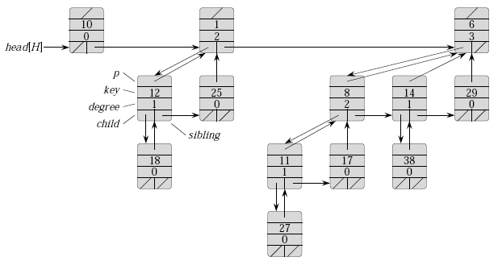


Slide 7
Operations on Binomial Heaps
find-min
delete-min
Union
Insert
Dec-key
Notes:
Binary Heap < Binomial Heap < Fibonacci Heap
This is only with respect to performance. From Wiki,
+------------+---------------+----------+-----------+
| Operation | Binary | Binomial | Fibonacci |
+------------+---------------+----------+-----------+
| Find-min | Θ(1) | Θ(1) | Θ(1) |
| delete-min | Θ(log n) | Θ(log n) | O(log n) |
| insert | Θ(log n) | Θ(1) | Θ(1) |
| dec-key | Θ(log n) | Θ(log n) | Θ(1) |
| merge | Θ(m log(n+m)) | O(log n) | Θ(1) |
+------------+---------------+----------+-----------+

Slide 8
Operations on Binomial Heaps
Find-min
The procedure returns a pointer to the node having minimum value in the binomial heap H.
A binomial heap is heap-ordered, the node with minimum value in a particular binomial tree is at the root node of the binomial tree. The procedure checks all roots.
Since there are at most log n + 1 roots to check, the running time of this procedure is O(log n).
Notes:
Binary Heap < Binomial Heap < Fibonacci Heap
This is only with respect to performance. From Wiki,
+------------+---------------+----------+-----------+
| Operation | Binary | Binomial | Fibonacci |
+------------+---------------+----------+-----------+
| Find-min | Θ(1) | Θ(1) | Θ(1) |
| delete-min | Θ(log n) | Θ(log n) | O(log n) |
| insert | Θ(log n) | Θ(1) | Θ(1) |
| dec-key | Θ(log n) | Θ(log n) | Θ(1) |
| merge | Θ(m log(n+m)) | O(log n) | Θ(1) |
+------------+---------------+----------+-----------+

Slide 9
Operations on Binomial Heaps
Example: find-min
Head [H]
12
7
9
11
27
10
14
36
16
12
18
21
19
X
Head [H]
12
7
9
Min = 12
11
27
10
14
36
16
12
18
21
19

Slide 10
Operations on Binomial Heaps
Y
X
Head [H]
12
7
9
11
27
10
14
36
Min = 7
16
12
18
21
19
Min = 7
Y
X
Head [H]
12
7
9
11
27
10
14
36
16
12
18
21
19

Slide 11
Union two Binomial Heaps
Union -- the procedure of uniting two binomial heaps into one binomial heap
Algorithm: given binomial heaps H1 and H2
Step 1. merge H1 and H2, i.e. link the roots of H1 and H2 in non-
decreasing order.
Step 2. restoring binomial heap by linking binomial trees of the same
degree together: traverse the linked list, keep track of three
pointers, prev, ptr and next.
Case 1: degrees of ptr and next are not same, move ahead.
Case 2: If degree of next->next is also same, move ahead.
Case 3: If key of x is smaller than or equal to key of next,
make next as a child of ptr by linking it with ptr.
Case 4: If key of ptr is greater, then make ptr as child of next.

Slide 12
Uniting two Binomial Heaps
Union_Binomial-Heap(H₁, H₂)
Step 1: SET H = Create_Binomial-Heap()
Step 2: SET Head[H] = Merge_Binomial-Heap()
Step 3: Free the memory occupied by H1 and H2
Step 4: If Head[H] = NULL, then RETURN
Step 5: SET PREV = NULL, PTR = Head[H] and NEXT = Sibling[PTR]
Step 6: Repeat Step 7 while NEXT ≠ NULL
Step 7: IF Degree[PTR]≠Degree[NEXT] OR (Sibling[NEXT]≠NULL AND Degree[Sibling[NEXT] = Degree[PTR]), then
  SET PREV = PTR, PTR = NEXT
  ELSE IF Val[PTR] ≤ Val[NEXT], then
  SET Sibling[PTR] = Sibling[NEXT]
  Link_Binomial-Tree(NEXT, PTR)
  Else
    IF PREV = NULL, then
  Head[H] = NEXT
  ELSE
  Sibling[PREV] = NEXT
Link_Binomial-Tree(PTR, NEXT)
SET PTR = NEXT
SET NEXT = Sibling[PTR]
Step 8: RETURN H

Slide 13
Uniting two Binomial Heaps
Time complexity of union operation
If H1 contain n1 nodes and H2 contain n2 nodes, then H1 contains at most 1og n1 + 1 roots and H2 contains at most 1og n2 + 1 roots, H contains at most 1og n2 + 1og n1 + 2 ≤ 2 1og n + 2 = O(1og n)
Since, n = n1 + n2, the merge takes O(log n) time.
Each iteration (the step 2) takes O(1) time. There are at most
1og n1 + 1og n2 + 2 iterations, the total time is thus O(log n).

Slide 14
Example of Union operation
Head [H₁]
12
7
9
27
10
14
12
Head [H₂]
18
4
8
7
10
14
36
19
29
18
21
12
18
21
31
36
24
19
39

Slide 15
Example of union operation
PTR
NEXT
Head [H]
12
18
7
4
9
8
27
19
10
14
7
10
14
36
12
29
18
21
12
18
21
31
36
24
19
39
PTR
NEXT
Head [H]
12
7
4
9
8
18
27
19
10
14
7
10
14
36
12
29
18
12
18
21
21
31
36
24
19
39

Slide 16
Example of union operation
PREV
PTR
NEXT
Head [H]
12
7
4
9
8
18
27
19
10
14
17
10
14
36
12
29
18
21
12
18
21
31
36
24
19
39
PREV
PTR
NEXT
Head [H]
12
4
9
8
7
19
10
14
17
10
14
36
18
27
12
29
18
21
12
18
21
31
36
24
19
39

Slide 17
Unite the Binomial Heaps given below
PREV
PTR
NEXT
Head [H]
12
9
8
18
4
10
14
17
10
14
36
7
19
12
29
18
21
12
18
21
31
27
36
24
19
39

Slide 18
Inserting a new node
Insert --- insert a node x into binomial heap H.
Algorithm
Step 1. create a new binomial heap H1 of one node of value x
Step 2. Unite H1 and H.
Insert_Binomial_Heap()
Step 1: SET H’ = Create_Binomial-Heap()
Step 2: SET Parent[x] = NULL, Child[x] = NULL and sibling[x] = NULL, Degree[x] = NULL
Step 3: SET Head[H’] = x
Step 4: SET Head[H] = Union_Binomial-Heap(H, H’)
Step 5: END
Time complexity: ? Space complexity: ?

Slide 19
extracting-min / delete-min
Delete-min – delete node with minimum key from binomial heap H.
Algorithm
Step 1. call find-min to find min node x of H
Step 2. remove x from root list of H
Step 3. create a new binomial heap H1 by delete x and reverse its
children
Step 4. call union(H, H1)
Time complexity: ? Space complexity: ?

Slide 20
Extracting the node with minimum key
Min-Extract_Binomial Heap (H)
Step 1: Find the root R having minimum value in the root list of H
Step 2: Remove R from the root list of H
Step 3: SET H' = Create_Binomial-Heap()
Step 4: Reverse the order of R's children thereby forming a linked list
Step 5: Set head[H'] to point to the head of the resulting list
Step 6: SET H ₌ Union_Binomial-Heap(H, H’)
Step 7: Return R

Slide 21
Extracting the node with minimum key
Example: Extract the node with minimum value from the binary heap
given below.
Head [H]
18
8
4
19
12
16
5
10
14
36
21
29
18
21
12
18
21
31
36
24
19
39
R
4
Head [H]
18
8
5
10
14
36
19
12
16
29
18
21
12
18
21
21
31
36
24
19
39

Slide 22
Extracting the node with minimum key
Head [H]
18
8
Head [H’]
36
14
10
5
19
12
16
21
12
18
29
18
21
21
19
31
36
24
39
Head [H]
36
14
5
12
21
8
29
18
21
21
10
12
16
31
36
24
12
18
21
39
19

Slide 23
Decreasing a value of a node
The algorithm to decrease the value of a node x in a binomial heap H is given below. In the algorithm the value of the node is overwritten with a new value k, less than the current value of the node. The Binomial-Heap_Decrease_Val procedure takes O(lg n) time as the maximum depth of node x is lg n, so the while loop will iterate at most lg n times.
Binomial-Heap_Decrease_Val(H, x, k)
Step 1: IF Val{x] < k, then Print “ ERROR”
Step 2: SET Val[x] = k
Step 3: SET PTR = x and PAR = Parent[PTR]
Step 4: Repeat while PAR ≠ NULL and Val[PTR] < Val[PAR]
Step 5: SWAP ( Val[PTR}, Val[PAR] )
Step 6:

Slide 24
Deleting a node
Once we have understood the Binomial-Heap_Decrease_Val procedure, it becomes very easy to delete a node x's value from binomial heap H in O(lg n) time. To start with the algorithm we set the value of x to - ∞. Assuming that there is no node in the heap that has a value less than -∞. The algorithm to delete a node from a binomial heap can be given as below.
Binomial-Heap_Delete-Node(H, x)
Step 1: Binomial-Heap_Decrease_Val(H, x, -∞)
Step 2: Min-Extract_Binomial-Heap(H)
Step 3: END

Slide 25
Deleting a key
Example: Delete the node with value 12 from the binomial heap H.
Head [H]
36
14
5
12
21
8
29
18
21
21
10
12
16
31
36
24
12
18
21
39
19
Head [H]
36
14
5
12
21
8
29
18
21
PAR
21
PTR
10
12
16
31
36
24
-∞
18
21
39
19

Slide 26
Deleting a key
(Contd.)
Head [H]
36
14
5
12
21
PAR
8
29
18
21
PTR
21
-∞
12
16
31
36
24
10
18
21
39
19
PAR
Head [H]
36
14
5
12
21
PTR
-∞
29
18
21
21
8
12
16
31
36
24
10
18
21
39
19

Slide 27
Deleting a key
(Contd.)
PTR
Head [H]
36
14
-∞
12
21
5
29
18
21
21
8
12
16
31
36
24
10
18
21
39
19
Head [H]
36
14
-∞
12
21
5
29
18
21
21
8
12
16
31
36
24
10
18
21
39
19

Slide 28
Deleting a key
(Contd.)
Head [H]
36
14
Head [H’]
5
29
18
12
21
8
12
16
31
36
24
10
18
21
39
29
19
Head [H]
36
18
5
24
14
8
12
16
29
12
21
10
18
21
31
36
21
19
39

